Slide 1
Entity Framework Core
.Net Advanced

Slide 2
Interacting with your EF Core Model

Slide 3
Overview
Logging database commands and more
Inserting, updating and deleting simple objects
EF Core’s batch command support
Query against the data model
Filtering queries
Notes:
Overview
In this module, we'll focus on interacting with simple objects and then continue in the next module by adding in relationships. You'll start by learning how to insert, update, and delete data using the DbContext and your data model.
We'll check out the batch support that EF Core has for data modification commands going to the database.
Once there is some data in the database, you'll learn how to use EF Core and LINQ to write and execute queries, including various ways to filter what data is returned from the database.
We’ll start with how to use EF Core's logging capabilities so that we'll be able to watch what kind of SQL is getting sent to the database.

Slide 4


Slide 5
Start Solution
We will use the SamuraiApp solution created in the previous chapter.

Slide 6

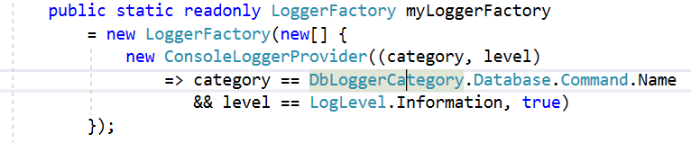
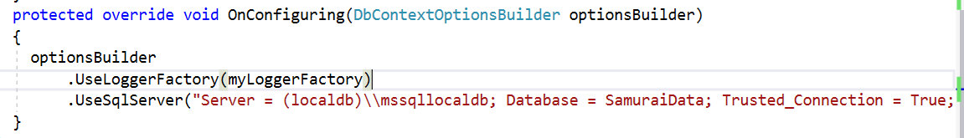
Getting EF Core to output SQL Logs
Install Nuget Package
In Context class
Notes:
Getting EF Core to Output SQL Logs
As you write and run the code for interacting with the data model, you are able to see the SQL commands that are created and executed by EF Core. To do that, You have to use the logging that's built right into .NET Core and leveraged by EF Core. The logging code will go into the Samurai Context class. You need to install the Microsoft Extensions Logging Console package to the data project before you can do that. Then you can configure the context to always output its logs to a console window.
First, you create a field called myLoggerFactory that uses the .NET Core logger factory to create a specialized console logger. .NET Core's logging can show you a lot of information, so you can put filters in. The first filter we add is to only show the SQL commands ( no processing messages, connections, or any of the other information that the log collects). The second filter defines the level of detail, so we get just basic information that will keep out details like stack traces and error messages.
Once you've defined the logger factory, you have to go down to the OnConfiguring method and tell the model builder to use a logger factory (the factory that we just created above). Now every time you use the SamuraiContext, the command that it executed on the database will be output to the console window.
Tip: if you want to show the SQL commands in the Debug window during debugging, you can use the DebugLoggerProvider instead of the ConsoleLoggerProvider (install NuGet package Microsoft.Extensions.Logging.Debug).
Note: you might need to update the Logging NuGet packages to make it work with a classic .NET Framework library.

Slide 7


Slide 8
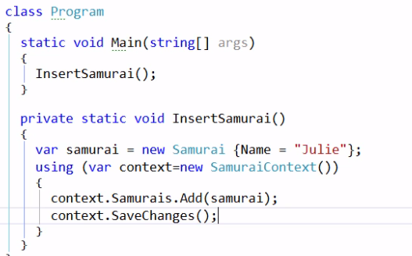
Inserting Simple Objects
Notes:
Inserting Simple Objects
Till now, we haven’t created any data in the database. So we will create a new method called InsertSamurai() to add a Samurai to the database.
We create a new Samurai object and set its name and then we instatiate a new SamuraiContext. In the context we defined DbSets for Samurai, Battle and Quote. The DbSet is how we interact with each set of types. We use context.Samurais to work with our set of Samurais and use Add() to add that new Samurai into our DbSet.
It is also possible to add directly from the context (new for EF Core) by using context.Add(samurai);

Slide 9
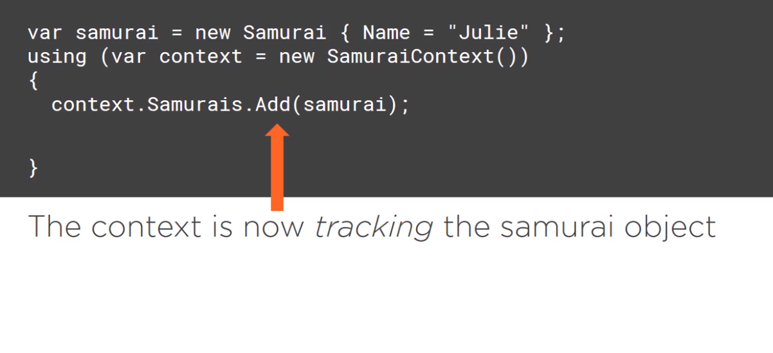
Inserting Simple Objects
Notes:
Inserting Simple Objects
Now the context is aware of the samurai and we refer to this as Tracking. We can use the DbContext SaveChanges method.

Slide 10
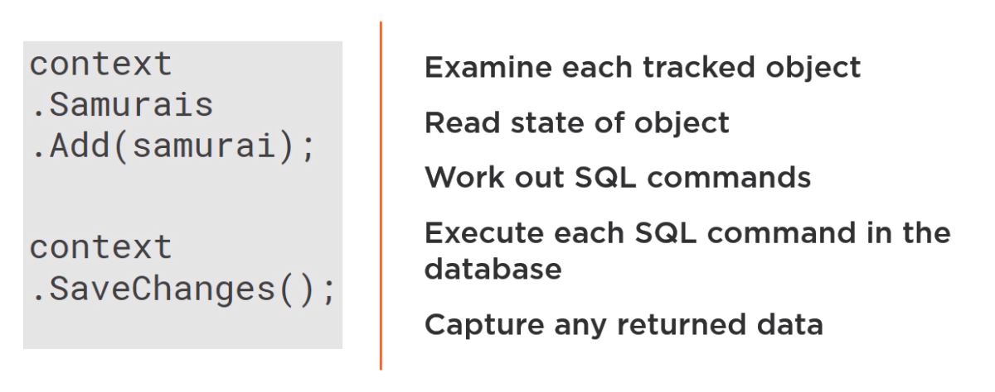
SaveChanges Internal Workflow
Notes:
SaveChanges Internal Workflow
The SaveChanges method will look at all the different objects that the context is tracking (in this case, just the single samurai) and look at its understanding of the state of that object because we used the Add method, the context is aware that this samurai is new and should be inserted into the database.
Because we used the Add method, the context is aware that this samurai is new and should be inserted into the database.
With that information, it will coordinate its comprehension about how the Samurai class and its properties map to the database along with the SQL Server provider to construct the correct SQL insert statement and then it will execute that statement on the database.
If that command returns any results, EF Core will read them as well.

Slide 11
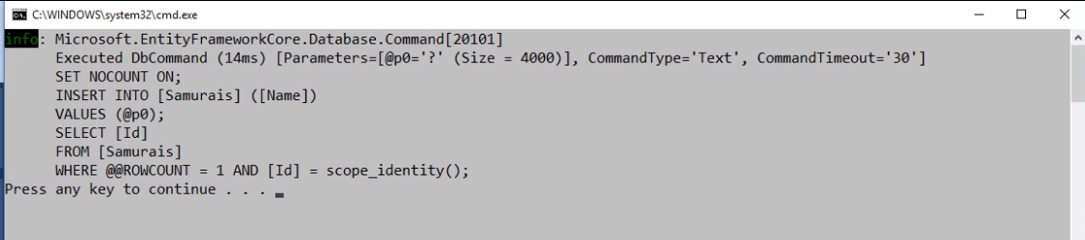
Inserting Simple Objects
SaveChanges always wraps its work in a Database Transaction.
Notes:
Inserting Simple Objects
When we run the application, we get all the logging information. If you open up SQL Profiler, you can see that EF Core wrapped the command in a database transaction. SaveChanges always wraps its work in a DB transaction, and if SaveChanges is causing multiple commands to be executed on the database, if any of those fails, it will roll back all of them. This is default behavior.
In the log, you can see an INSERT command and then it passes in the value of the name as a parameter. When it's done, it returns the new value that the database generated for the Id property. EF Core will grab that returned value and use it to update the Samurai objects Id property.
By default, the logs don't show the values of the parameters for security purposes, but you can configure your context to show them with the options builder, EnableSensitiveDataLogging method, and notice that's once I've done that and I run the app again, I can now see the parameter values in the log and opening up the Samurais table on the database, there is the data I inserted.
SaveChanges always wraps its work in a DB transaction, and if SaveChanges is causing multiple commands to be executed on the database, if any of those fails, it will roll back all of them. This is default behavior.
In the log, you can see an INSERT command and then it passes in the value of the name as a parameter. When it's done, it returns the new value that the database generated for the Id property. EF Core will grab that returned value and use it to update the Samurai objects Id property. By default, the logs don't show the values of the parameters for security purposes, but you can configure your context to show them with the options builder EnableSensitiveDataLogging method, and notice you can see the parameter values in the log and opening up the Samurais table on the database, you can see the data you inserted.

Slide 12


Slide 13
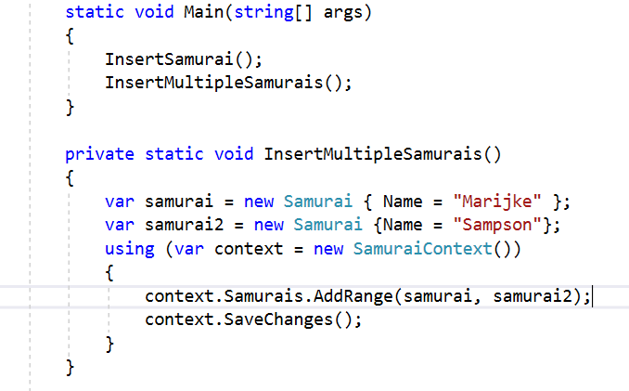
Batching Commands When Saving
Notes:
Batching Commands When Saving
EF Core supports bulk operations. You can do an insert with multiple objects.
Add a new method called InsertMultipleSamurais and start by copying the InsertSamurai and add a second samurai, Sampson. We could use a second DbSet Add command to add Sampson to the context, but we also have an AddRange method which you can use to add multiple objects. I can pass these objects into the AddRange method delimited by commas.

Slide 14
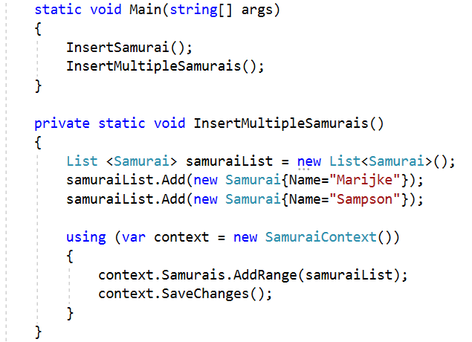
Batching Commands When Saving
Notes:
Batching Commands When Saving
You can also pass those objects in as a list, which means you can construct the list elsewhere in your code and then pass that list in to the AddRange method.

Slide 15
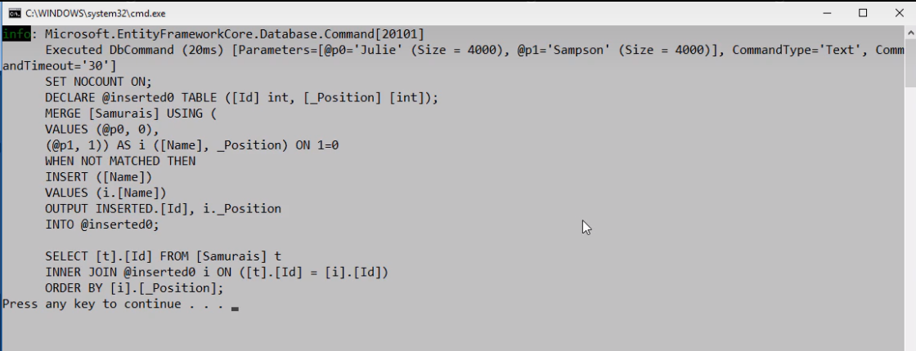
Batching Commands When Saving
Notes:
Batching Commands When Saving
Running this method, the log looks a lot different than it did before. The log shows that with the help of the SQL Server provider, EF Core sets up a series of table variables to prepare for the insert. There are two sets of data for the two different samurais, then it uses the SQL Server merge join to execute the actual insert into the samurais table.
There’s a blog post of Richie Rump that explains this operation in much more detail, including the performance benefits of how this SQL is constructed. You can find a link to his post in the resources listed at the end of this module.
The last bit of this SQL is just standard for an Entity Framework insert, it just has to return the generated keys to the objects.

Slide 16
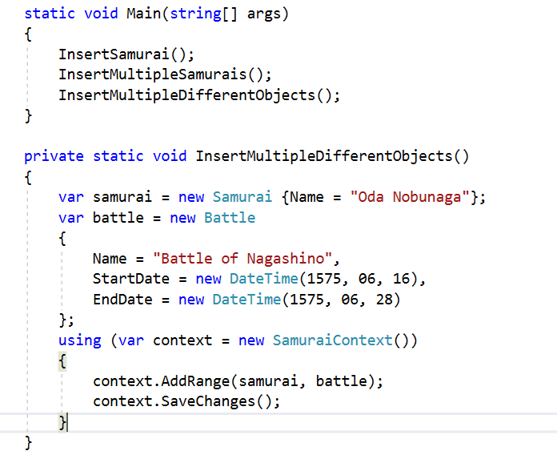
Batching Commands When Saving
Notes:
Batching commands when saving
You can add objects directly from the DbContext without specifying the DbSet because in EF Core, the DbContext has the ability to figure out which DbSet an entity belongs to. Here is a great use for that capability when you need to add, or update, or delete a variety of objects that are different types.
In this method, we are creating a new Samurai and a new Battle and the two objects aren't related to each other. We add them directly to the DbContext using the AddRange method. This is a really cool capability that we didn't have in older versions of EF. Before we would explicitly have to add the samurai to the samurai DbSet and the battle to the battle DbSet. This is something nice to be aware of.

Slide 17


Slide 18
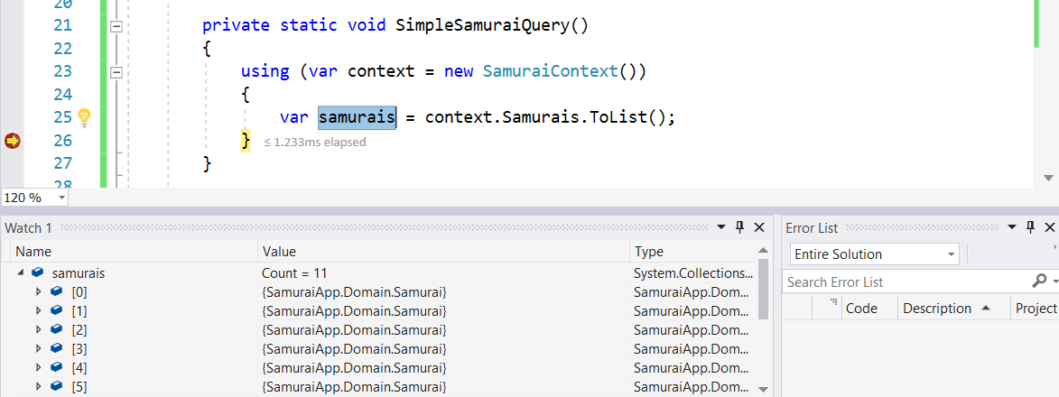
Querying Simple Objects
Notes:
Querying Simple Objects
Like the insert, a query is expressed against a DbSet, so you have to reference a new context instance, and then, the Samurais DbSet. You can append methods for querying from that set and just request all of the samurais from the database with a LINQ method ToList. ToList is a LINQ execution method that will trigger the query to be executed. This query will bring back all of the samurais as a list of samurais.
Put a breakpoint right after the query, run it, and you can see in the Locals window that the Samurais variable is now populated with the list of samurai objects.

Slide 19
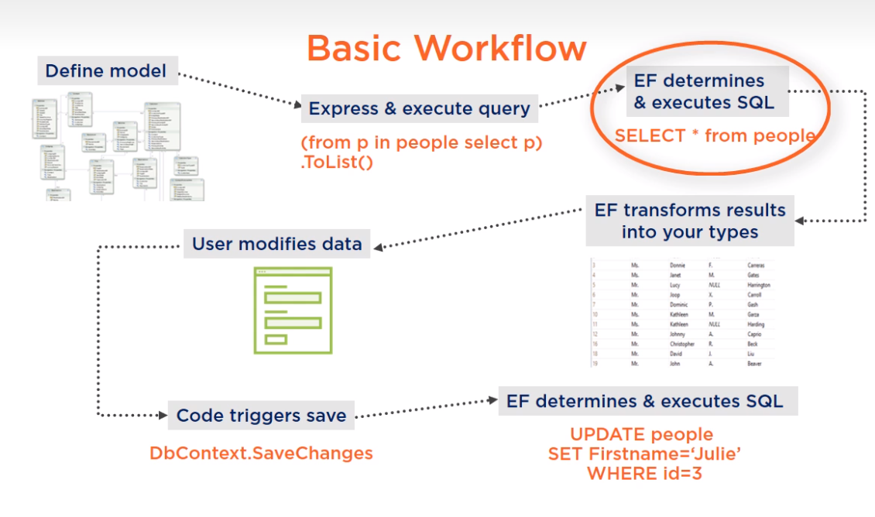
Querying Simple Objects
Notes:
Querying Simple Objects
What happened when this was run was that first EF Core transformed the query into the proper SQL, took care of the commands in the connection string, executed the query on the database, read the results that were returned, and then transformed those results into samurai objects.

Slide 20
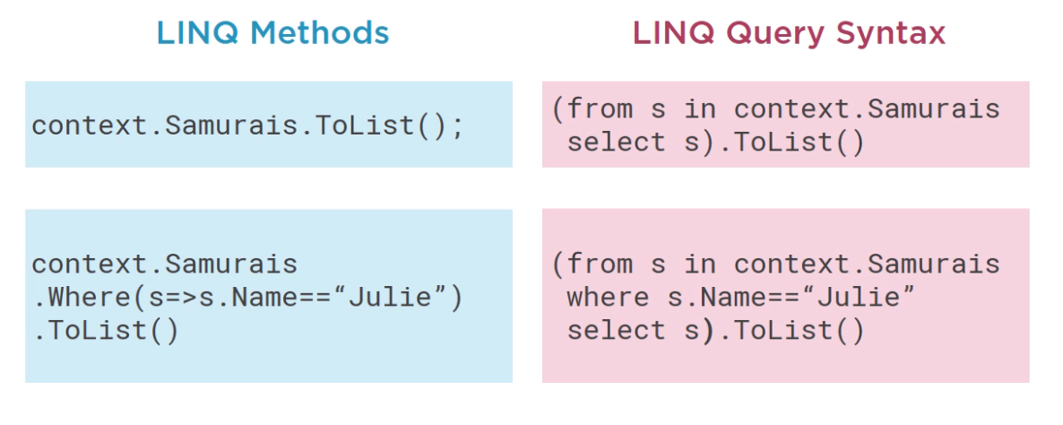
Querying Simple Objects
Two ways to express LINQ Queries
Notes:
Querying Simple Objects
There are two ways to express queries with LINQ, one is using the LINQ methods and the other is using LINQ query syntax. The LINQ query syntax looks more like a SQL statement, except you still have to use an execution method at the end.
The query itself is disconnected from the method that executes the query.

Slide 21
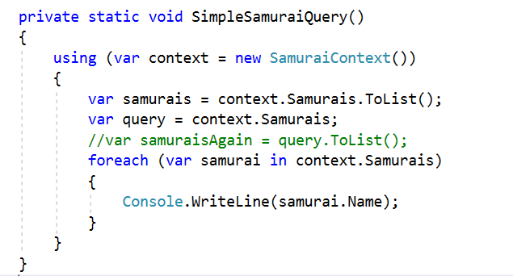

Querying Simple Objects
Notes:
Querying Simple Objects
On the slide you can see an example where a query is defined in one variable and then in another statement, You modify the query or you can append a LINQ execution method to it. In addition to a LINQ execution method, there is another way to trigger a query to execute besides using an execution method and that's by enumerating the query. As soon as EF Core sees that you actually want some data as it hits the enumeration, it gets that data from the database so that triggers it to execute. You don't have to define the query variable in advance, you can just enumerate over the query itself.

Slide 22
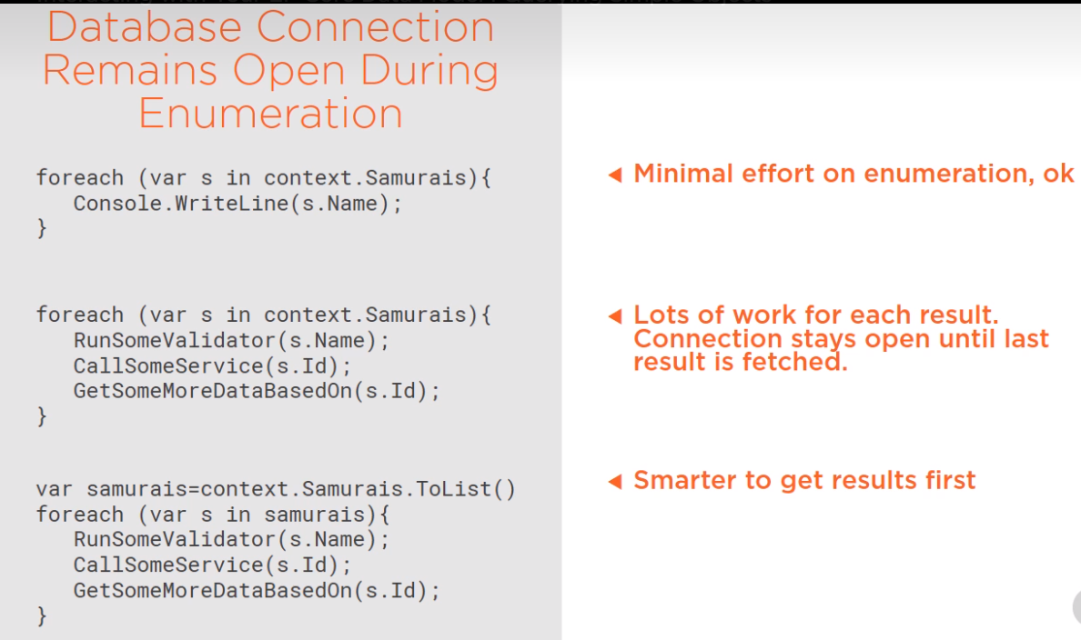
Querying Simple Objects
Notes:
Querying Simple Objects
There is a really important performance consideration to be aware of if you are depending on enumerations to go ahead and hit the database for you on the fly. At the beginning of that execution, the database connection gets opened and it will stay open until the enumeration is complete and all of the results have been streamed back. In some cases, that's perfectly fine, but in others, for example, if you start performing a lot of operations on each one of the results while you're looping through them, not only can it cause performance problems, it could also cause other side effects if other people are interacting with the same database. Its better to just use an explicit execution method, such as ToList, get all of the results into memory, and then do the processing. Your own scenario and performance testing should be able to guide you to the best workflow for your solution.

Slide 23


Slide 24
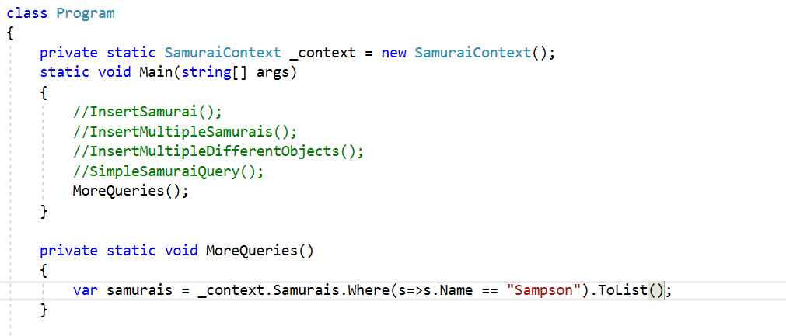
Filtering Data in Queries
Notes:
Filtering Data in Queries
You probably don't always want to just get all of the rows from a database table. There are a few more capabilities of LINQ.
Change the Program Class: Rather than instantiating a new context for every one of the methods, create a class-wide context that is instantiated at startup. You can use it whenever you want, and with this change, it's important to understand that you’re only running one method at a time. So each time that you run one of these methods, it's working with a fresh instance of the context.

Slide 25
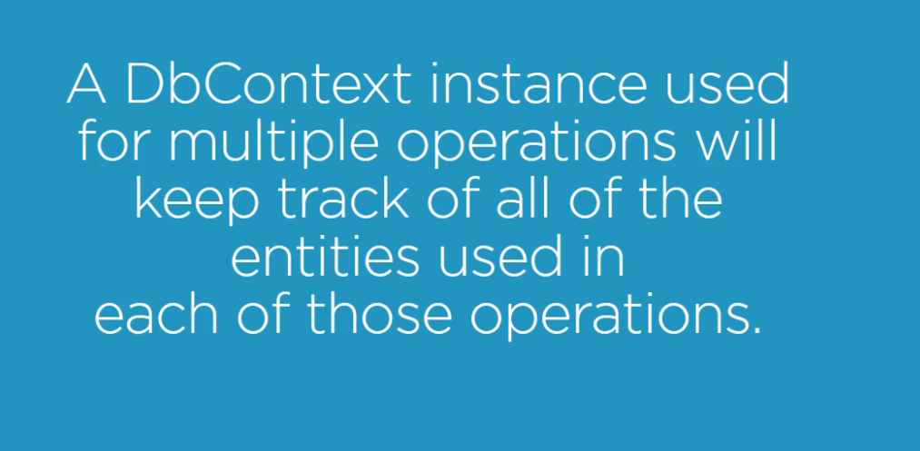
Filtering Data in Queries
Notes:
Filtering Data in Queries
If you run multiple methods on the same context, your results might be different.
We create a new method called MoreQueries. Instead of just getting all the samurais, we’re now filtering on those samurais whose name is Sampson. We will do this with the LINQ Where method which takes a lambda that is used to express the filter you execute it with a ToList method.

Slide 26
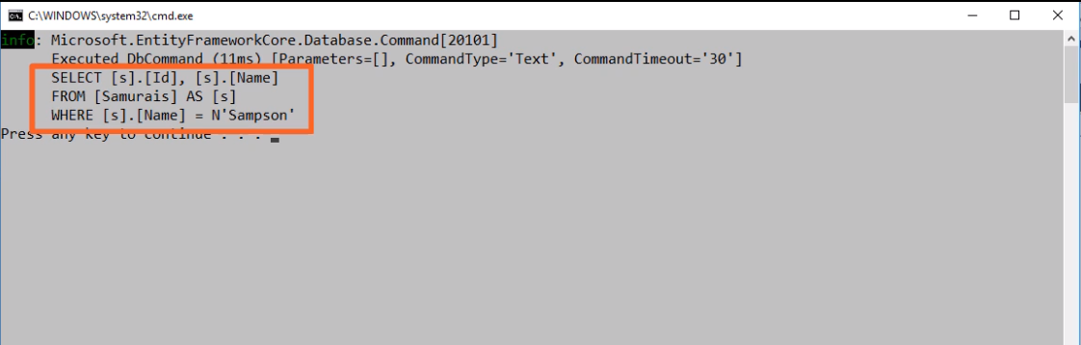
Filtering Data in Queries
Notes:
Filtering Data in Queries
When you run the application and look at the logs in the console, keep in mind that you filter the log (configured in Context class) so you can only see the commands, but what you can't see is that EF Core is compiling and optimizing the query in order to work out the SQL command.
Depending on the complexity of the query, it may have to go through a series of optimizations to get down to what it thinks of as the best option. In the end, you can see that the DbCommand is just a pretty simple SELECT statement with a predicate and the search value, Sampson, hardcoded directly into the SQL. That's following a pattern that Entity Framework has followed since day one with Entity Framework.

Slide 27
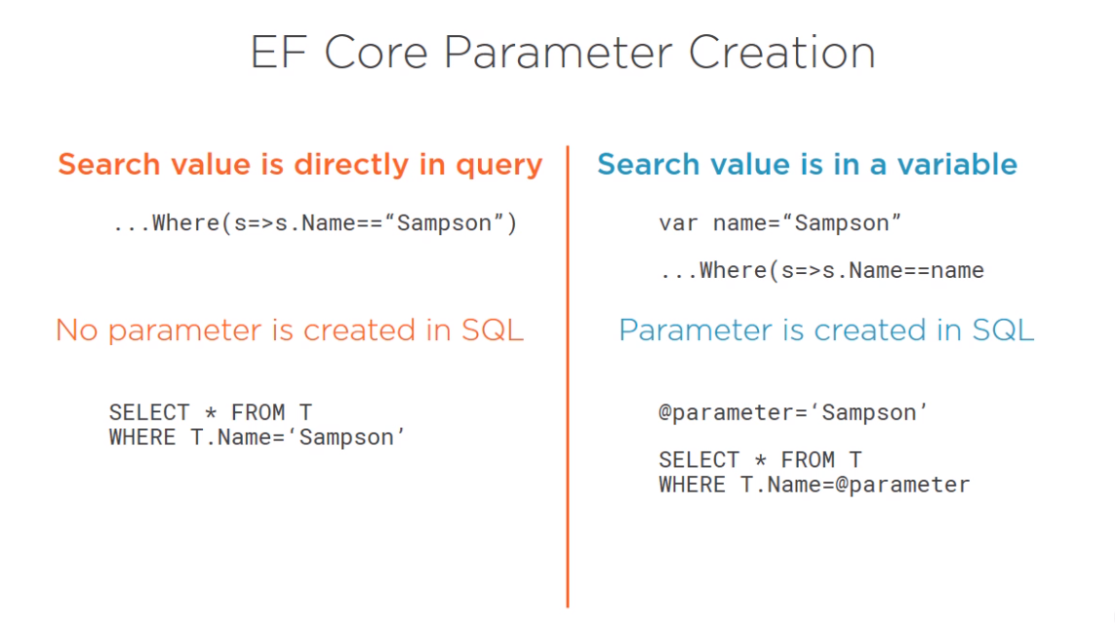
Filtering Data in Queries
Notes:
Filtering Data in Queries
If you hardcode the values into the query, then EF assumes that the value didn't just randomly come from some data entry somewhere and it's safe, so it just hardcodes the value into the SQL, but we're much less likely to write a query that way. What's more likely is that you do have a variable, some data that came in from somewhere.

Slide 28
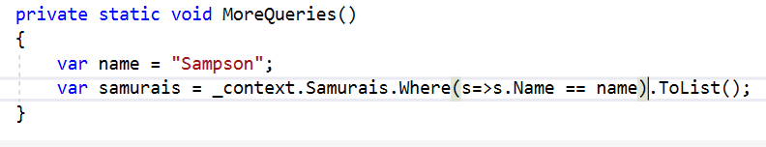
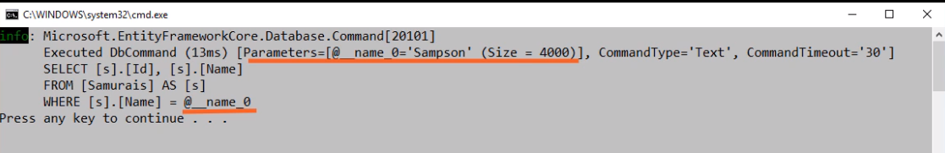
Filtering Data in Queries
Notes:
Filtering Data in Queries
Let's pretend that this name variable with a value Sampson was passed in from somewhere else. When we use the variable in the expression, EF Core does parameterize the query, which you can see in the log.

Slide 29
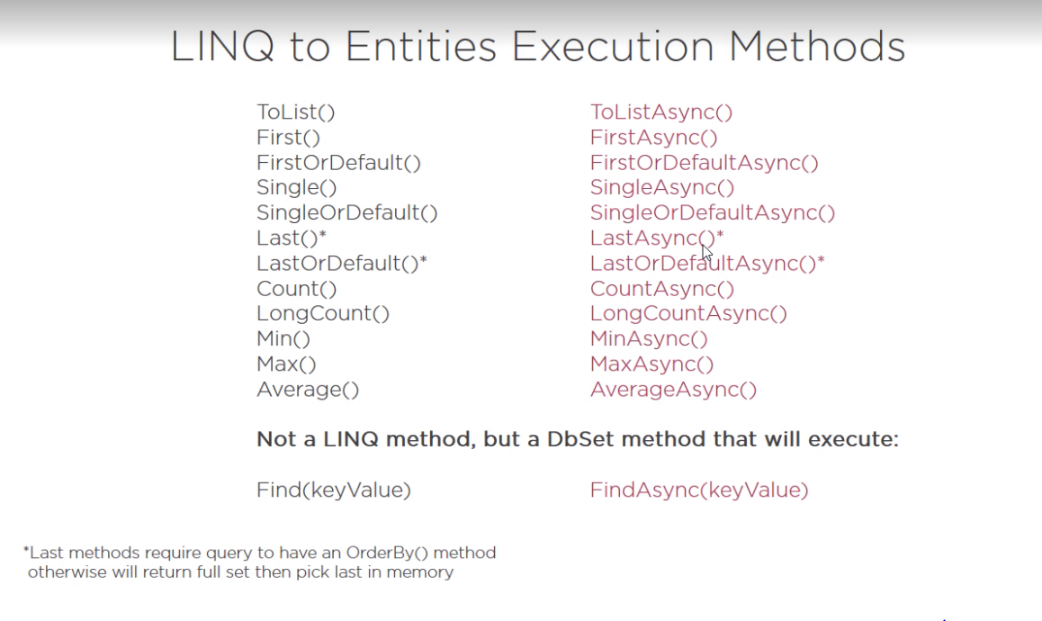
Filtering Data in Queries
Notes:
Filtering Data in Queries
On the slide you can find a list of all the execution methods and each of the methods has an asynchronous counterpart. All of them, except for ToList, perform some type of aggregation when they execute. The logic of the aggregation (First, Max, Count or Average) are incorporated into the SQL that's sent to the database.
There are a few gotchas to be aware of with these methods. One is with the Last and LastOrDefault methods. Those require that your query also does some sorting with an OrderBy LINQ method in order to create SQL that will express the full query in the database.
Another gotcha to watch out for is when choosing between the first methods and the single methods. Single expects there to be only one result from the database that matches a query. If there is more than one, it will throw an error, but the first method will just select the first result that matches the query.
Finally, you need to understand the difference between the First, Single, and Last methods and their OrDefault counterparts. If the results of the plain methods are empty, EF Core will throw an exception, but if the results of FirstOrDefault, SingleOrDefault or LastOrDefault are empty, EF will return null.
Most often, you'll want to use the OrDefault methods and handle a null response as opposed to an exception, but there may be times when an exception is the correct response and you'll choose the plain version of the methods. There are some LINQ courses on Pluralsight where you can dig deeper into constructing queries.

Slide 30
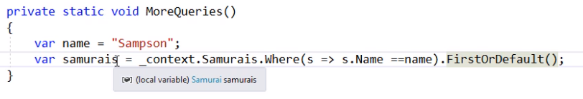
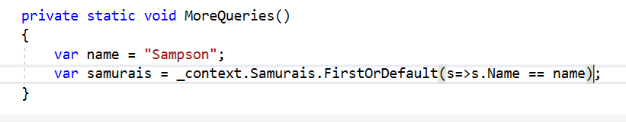
Filtering Data in Queries
Notes:
Filtering Data in Queries
In code we replace the ToList execution method with FirstOrDefault. If you hover over the return variable, you can see that the compiler knows the result will be a samurai object, not a list. You can make your expression a little more efficient because you can use the predicate as a parameter of FirstOrDefault rather than using the combination of the where method and FirstOrDefault.

Slide 31
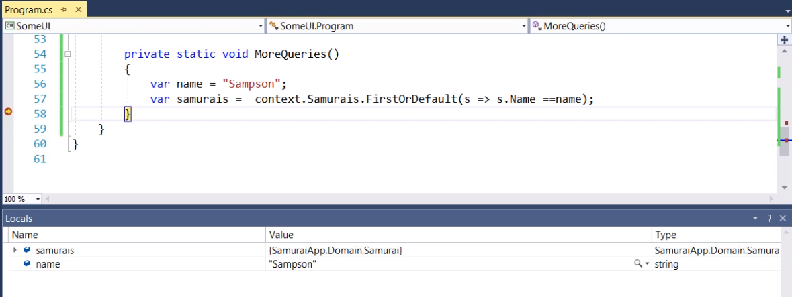
Filtering Data in Queries
Notes:
Filtering Data in Queries
When you run it, you can see in the Locals window that the result is a samurai object.

Slide 32
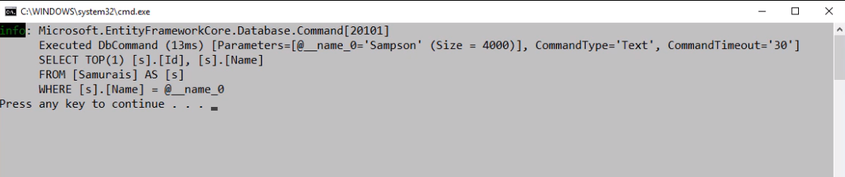
Filtering Data in Queries
Notes:
Filtering Data in Queries
The way FirstOrDefault resolves as SQL is with a SELECT TOP 1 query. If nothing is returned, EF Core will take care of providing the default a null value.

Slide 33
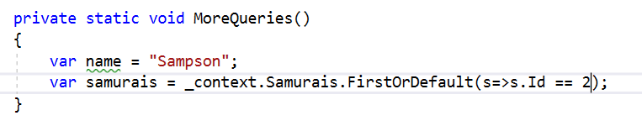
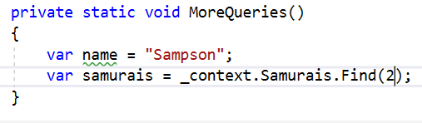
Filtering Data in Queries
Notes:
Filtering Data in Queries
What if you wanted to filter on the key value? You could use FirstOrDefault, but there is a method of DbSet called Find, which is for retrieving an object by using its key value. This isn't a LINQ method but a DbSet method that will execute right away. The Find method has a great benefit, that if the object with that key is already in memory and being tracked by the DbContext, EF Core won't waste its time executing a query on the database, it will just return the object that it's already tracking.

Slide 34
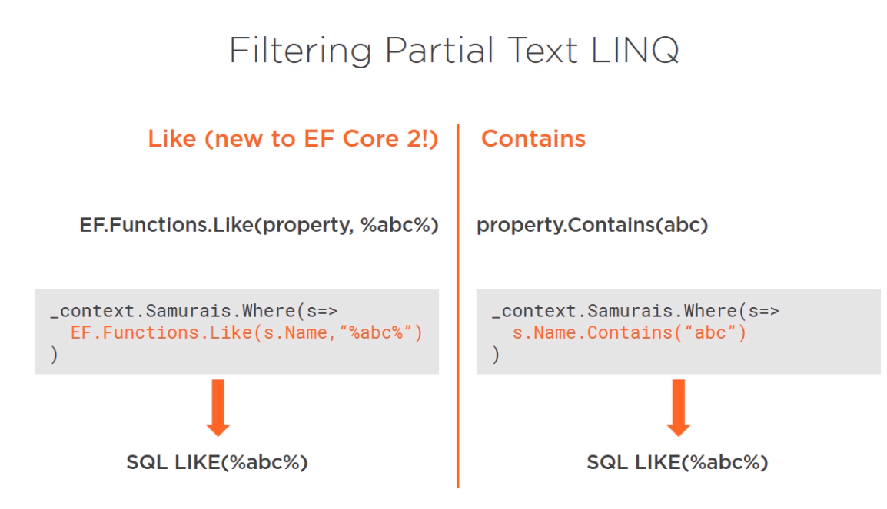
Filtering Data in Queries
Notes:
Filtering Data in Queries
There is another way to filter queries, which is not only new to EF Core, but it's new as of EF Core 2. It’s the ability to write Like queries the way you can write them in SQL surrounded by wildcards. You could do this with the LINQ Contains method, but this may be more natural for many developers. In fact, the Contains method translates into a Like SQL query anyway, so this is even easier for EF to translate the query into SQL.

Slide 35
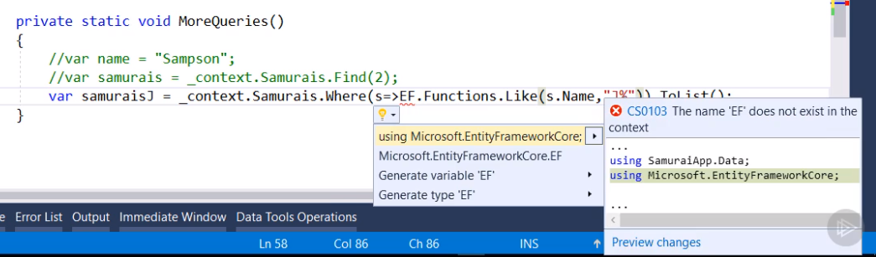
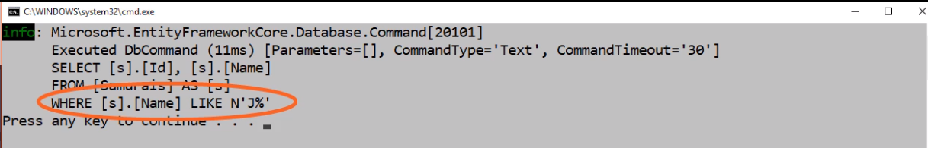
Filtering Data in Queries
Notes:
Filtering Data in Queries
We'll query for samurais whose name starts with capital J and this feature is possible thanks to the EF functions, which are built into EF Core. You can use the functions Like method, which takes the property you're searching as the first parameter and the expression you're searching for.
In this case, we'll just build a string that's a capital J followed by the percent symbol wildcard for anything that comes after J.
When you run the method and look at the SQL in the log, you can find the Like operator followed by J%.

Slide 36
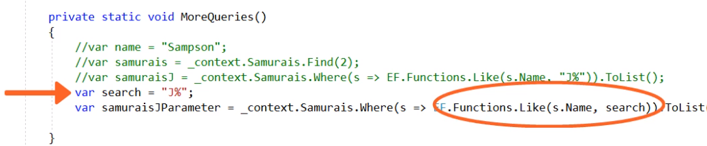
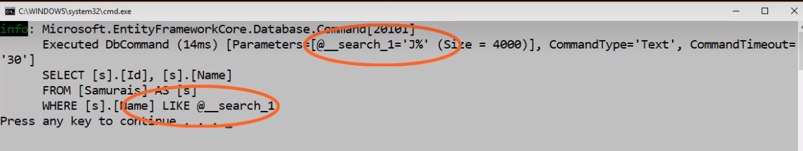
Filtering Data in a Query
Notes:
Filtering Data in a Query
If your search expression is in a variable, EF Core will parameterize the SQL Like query as you can see in this log.

Slide 37
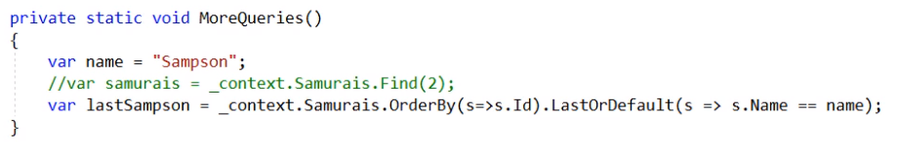
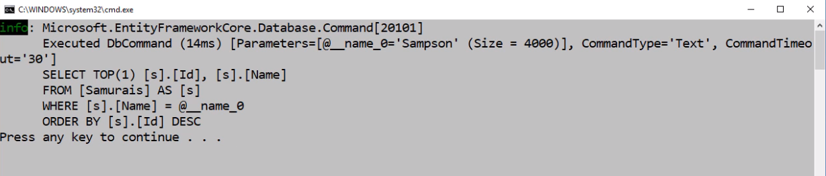
Filtering Data in a Query
Notes:
Filtering Data in a Query
There is a potential problem with the Last or LastOrDefault methods. A query using either of these methods needs to be sorted because it constructs the SQL with a descending sort. Just like the FirstOrDefault method, it uses SELECT TOP 1. EF Core is able to translate the full query into SQL and the database will only return a single row to memory.

Slide 38
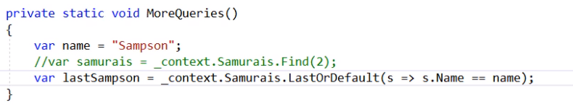
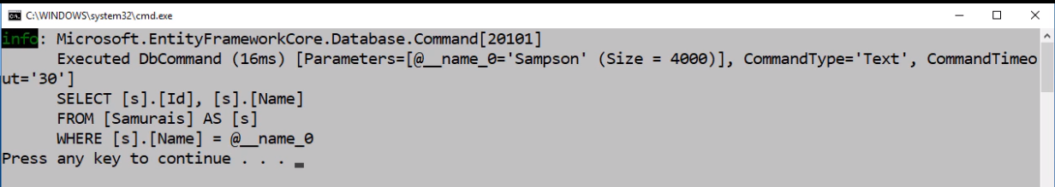
Filtering Data in a Query
Notes:
Filtering Data in a Query
If you don't include ordering, EF Core isn't going to be able to construct SQL that sorts and selects Top 1. What it will do is return the full set of results from the query into memory, and then in memory, EF Core will pick the last item from that set. That's what it will return from this statement.
If you have a lot of results in the initial query, this could lead to performance problems. Because LINQ queries are translated at runtime into SQL, the compiler isn't able to warn you about it in advance.
There is much more that you can learn about using LINQ in general. There are some other Pluralsight courses that dig more deeply into LINQ. The next thing we'll look at is querying across relationships.
- LINQ Fundamentals with C# 6.0 (Scott Allen)
LINQ Fundamentals (Scott Allen)
More Effective LINQ (Mark Heath)
Practical LINQ (Deborah Kurata)
LINQ Data Access (Scott Allen)
LINQ Architecture (Scott Allen)

Slide 39


Slide 40
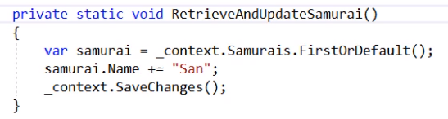
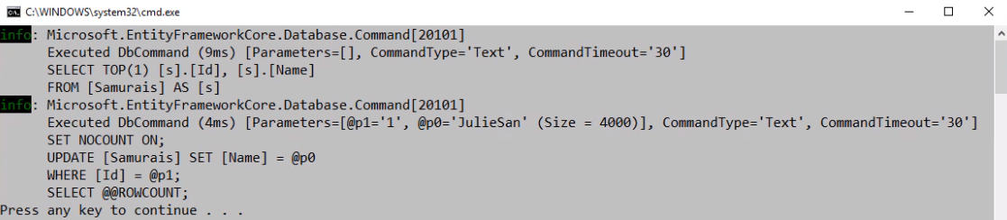
Updating Simple Objects
Notes:
Updating Simple Objects
While it's true that querying is the most common thing people do in their software, you probably need to know about updating as well.
We'll continue with our current focus on simple objects and start by retrieving a random samurai from the database. We'll modify it and call SaveChanges.
In the log, you can see the SELECT statement to get the samurai, the update statement as a result of the call to save changes, and EF Core passed in the Id of the entity getting updated along with the value that got changed and it performs the update using those parameters and returns the number of rows that were affected.
This was a super easy task for EF Core because the context was tracking the samurai from the time it was retrieved from the database to the time that the SaveChanges method was called. It was aware of exactly which property got modified, that it was an update, and because of that, it was able to execute a really efficient command. It would have been a lot more obvious if we had more properties in samurai. In the log it was clear that it was only passing in the Id, and that one property I modified.

Slide 41
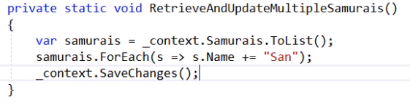
Updating Simple Objects
Notes:
Updating Simple Objects
You've already seen batch operations in action with inserts, let's take a look at a batch update.
RetrieveAndUpdateMultipleSamurais is a method for pulling back all of the existing samurais, updating them, and then calling SaveChanges.

Slide 42
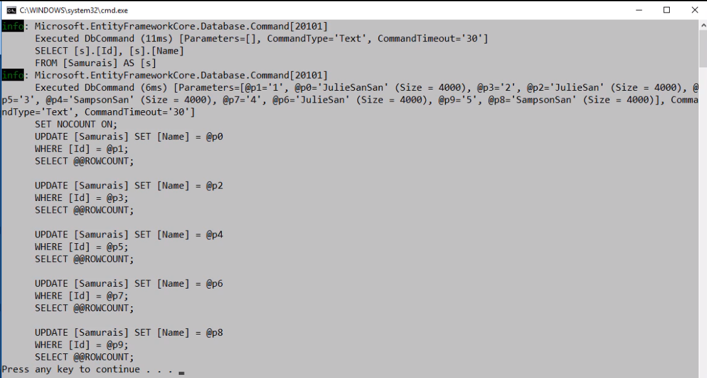
Updating Simple Objects
Notes:
Updating Simple Objects
Because the context is tracking them throughout the full operation, retrieving, updating, and saving, it knows exactly which property has changed and creates update commands just for those properties for each of the objects that was modified.
In a single call, it sends back all of the parameters, in this case, the Id and the new name for each of the samurais and then constructs four different update statements using the relevant parameters.

Slide 43
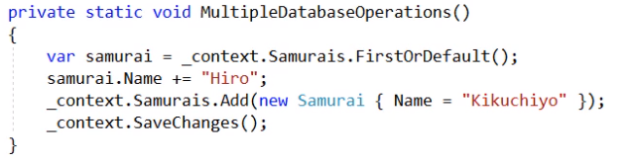
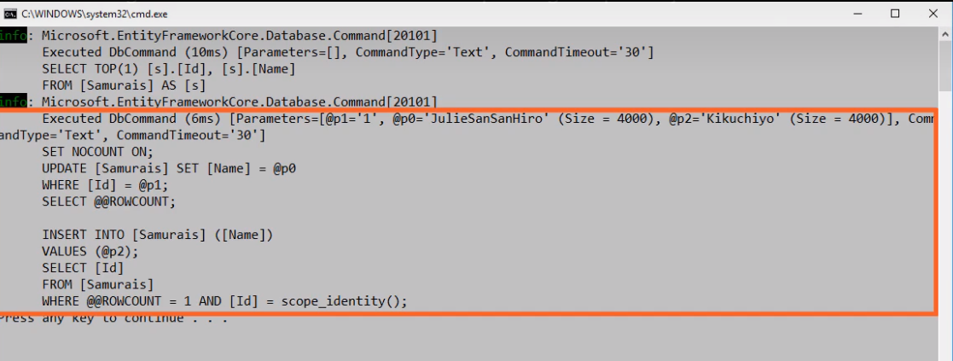
Updating Simple Objects
Notes:
Updating Simple Objects
Batch operations aren't limited to common operations. You can have a whole bunch of activities that the context is tracking, updates, inserts, and deletes, and when you call SaveChanges, it will still batch them all.
On the slide, you can see an example where we’re pulling back an editing of samurai and adding a new Samurai, and with the context tracking both of those, we call SaveChanges. You can see again the single database call sending in the Id and the new value of the samurai we got from the database, as well as a parameter for the name property of the samurai that we’re adding. The UPDATE command uses the first two parameters and the INSERT uses the parameter that was designated for that command.

Slide 44

Notes:
Deleting Objects with EF Core
We've seen how to insert and update data. Now it's time to learn about asking EF Core to delete data from the database. For developers new to Entity Framework, the way EF deletes might seem a little strange.

Slide 45
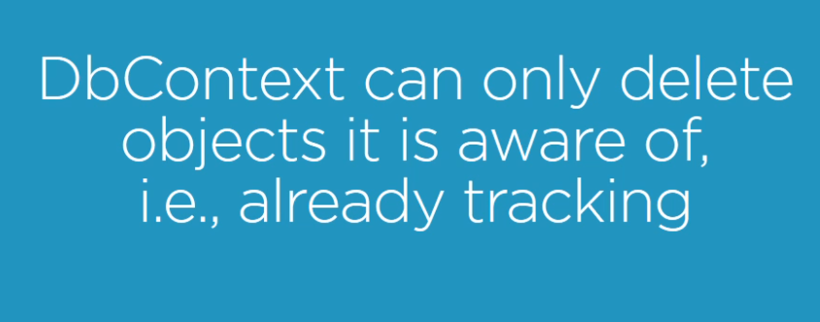
Deleting Objects with EF Core
Notes:
Deleting Objects with EF Core
That's because EF Core needs to be tracking an object in order to mark it as deleted so that it knows it should send a delete command to the database. That's easy enough if you already have that object at hand, and whether Entity Framework is already tracking that object or you're in a disconnected scenario.

Slide 46
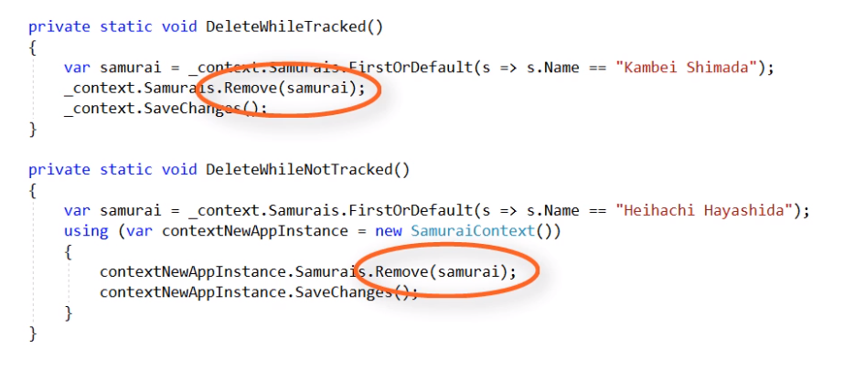
Deleting Objects with EF Core
Notes:
Disconnected Objects
You can just pass that object into the Remove method of either DbSet or directly from the DbContext.

Slide 47
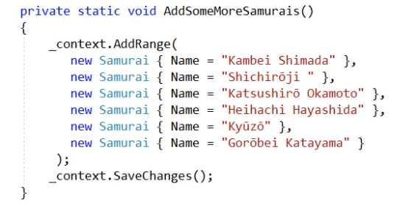
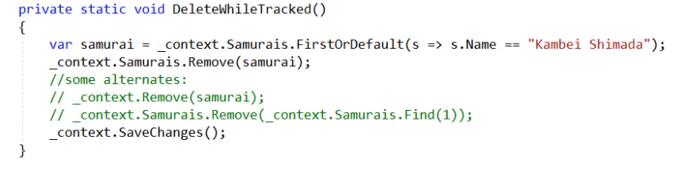
Deleting Objects with EF Core
Notes:
Deleting Objects with EF Core
The AddSomeMoreSamurais method ads a bunch of new Samurais into the database.
In the DeleteWhileTracked method, a samurai was queried and the object is still in memory. EF Core changes its known state to deleted when the DbSet Remove is called and the samurai instance is passed in.
When you call SaveChanges, it sends a DELETE command to the database.

Slide 48
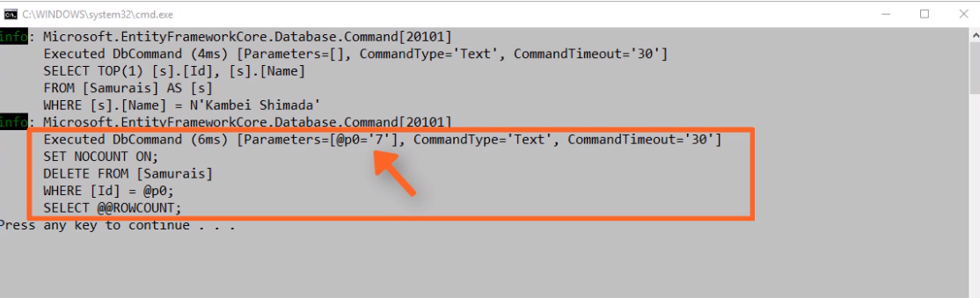
Deleting Objects with EF Core
Notes:
Deleting Objects with EF Core
Notice that all it sends is the primary key value because that's really all that's needed by the DELETE command.

Slide 49
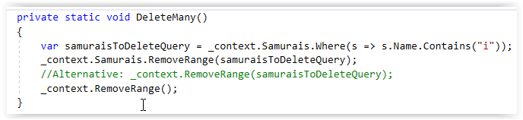
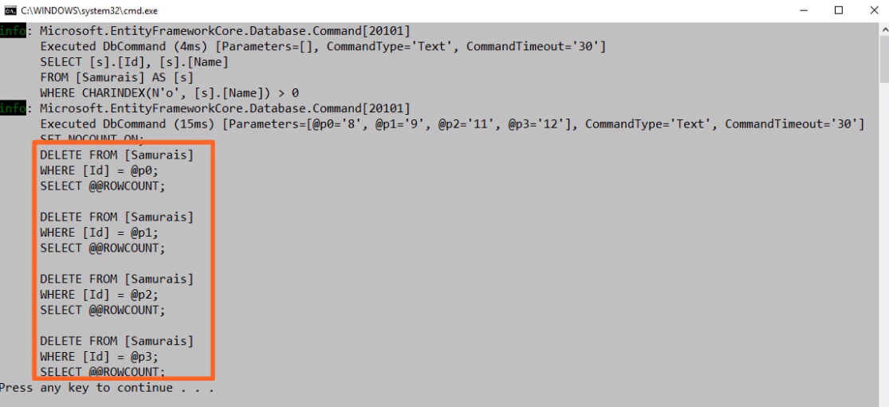
Deleting Objects with EF Core
Notes:
Deleting Objects with EF Core
Deletes will also be part of batches when you call SaveChanges. On the slide, you can see there were retrieved a set of samurais and then using RemoveRange to mark all of those for deletion.
When running, the log shows that the Ids of all four were sent in as parameters and we see the four delete commands. You can see in the Samurais Table that most of my new samurais are gone.

Slide 50

Deleting Objects with EF Core
Notes:
Deleting Objects with EF Core
If EF isn't tracking the object already, then just like it did for the disconnected updates, when you call the Remove method, first it will begin tracking the object and then it will mark it as deleted.

Slide 51

Deleting Objects with EF Core
Notes:
Deleting Objects with EF Core
If you think back to the first inserts we did, we created the new samurais outside of the DbContext and using add to start tracking and mark them as added.

Slide 52

Deleting Objects with EF Core
Notes:
Deleting Objects with EF Core
But what if you don't already have the object. Most likely, you would at least have the Id value of the object you want to delete. Unfortunately, it means you first have to query the database or call the Find method to retrieve the object so that you can pass it into the Remove method in order to tell the database to delete it. That is really annoying because it means two trips to the database.

Slide 53

Deleting Objects with EF Core
Notes:
Deleting Objects with EF Core
It also begs the question, why isn't there a Delete by Id method which just takes a key value just like the Find method does.
This is something developers have requested from Entity Framework for quite a while and there is a discussion of it in the EF Core repository on GitHub. The capability is on a backlog, which suggests that it will finally come to EF Core someday (maybe it'll be a contribution that you make to EF Core).

Slide 54

Deleting Objects with EF Core
Notes:
Deleting Objects with EF Core
If you really do hate the idea of that extra database trip in order to get the object from the database so that you can delete it from the database, you might prefer to use raw SQL or stored procedures.
On the slide, you can see an example of how you can use EF Core's DbContext.Database.ExecuteSqlCommand method to call a stored procedure and pass in a parameter.

Slide 55

Deleting Objects with EF Core
Notes:
Deleting Objects with EF Core
EF Core's DbSet also has a FromSql method that lets you execute queries using raw SQL or calling stored procedures. We won't be covering those features in this course. You can learn more about them by looking back at the EF Core Getting Started course for EF Core 1.0 and in a future intermediate course on EF Core 2.

Slide 56


